Slide 1
Advanced Programming
Lab 8, SIMD and OpenMP
于仕琪，廖琪梅，王薇

Slide 2
Topic
Intel Intrinsics
load, add, store
ARM Neon Intrinsics
load, add, store
Introduction to Python(1)
Install python
Read-Eval-Print Loop
Basic Types and Operations
Practice

Slide 3

Intel Intrinsics

Slide 4

SIMD@Intel
MMX: 1997, 8 registers, 64 bits,
SSE (Streaming SIMD Extensions): 1999, 128 bits
SSE2: 2000
SSE3: 2004
SSSE3: 2006
SSE4.1: 2006
SSE4.2
AVX (Advanced Vector Extensions): 2011, 256 bits
AVX2: 2013
AVX-512: 2016

Slide 5
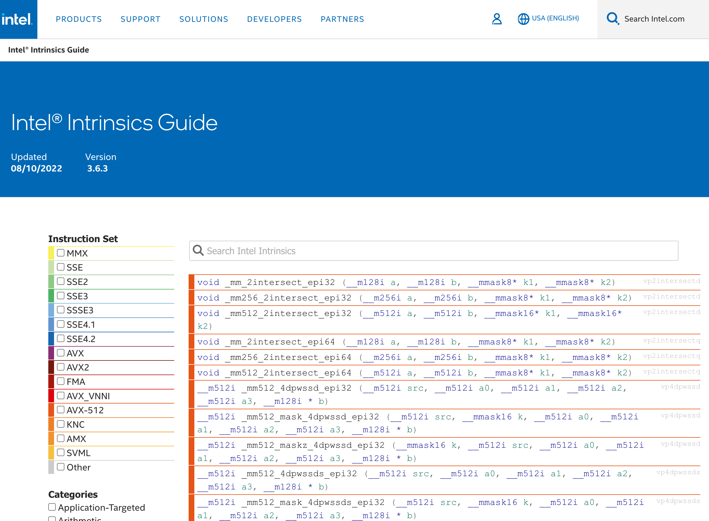
Intel® Intrinsics Guide
https://www.intel.com/content/www/us/en/docs/intrinsics-guide/index.html

Slide 6
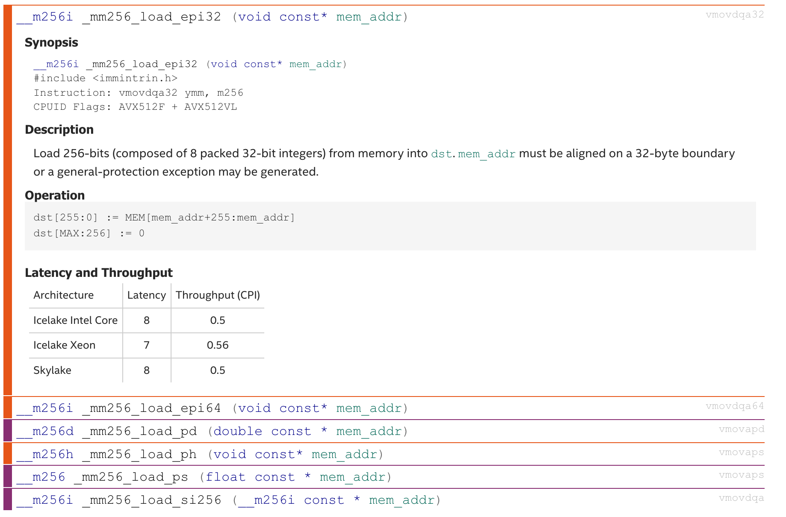
Load data from memory to registers
float * p = ...;
__m256 a;
a = _mm256_load_ps(p);

Slide 7
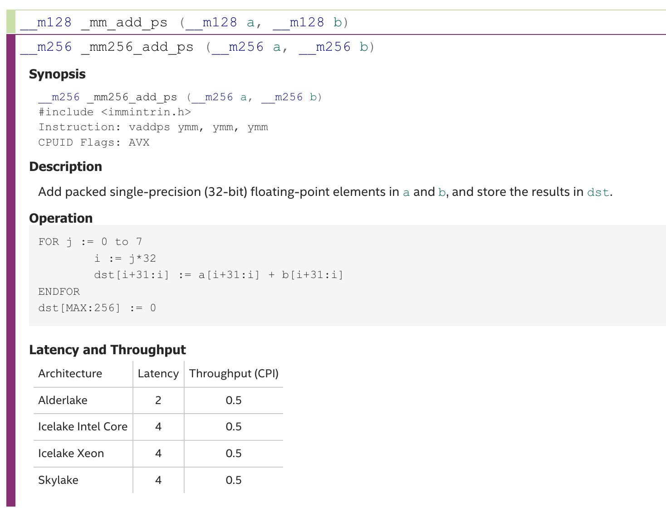
Add operation
s is for single precision floating point (float); d is for double precision floating point (double)
__m256 a, b, c;
a = _mm256_load_ps(p1 + i);
b = _mm256_load_ps(p2 + i);
c = _mm256_add_ps(a, b);
p is for packed data, all scalars will be in the operation.
s is for scalar, only the first scaler will be involved.

Slide 8
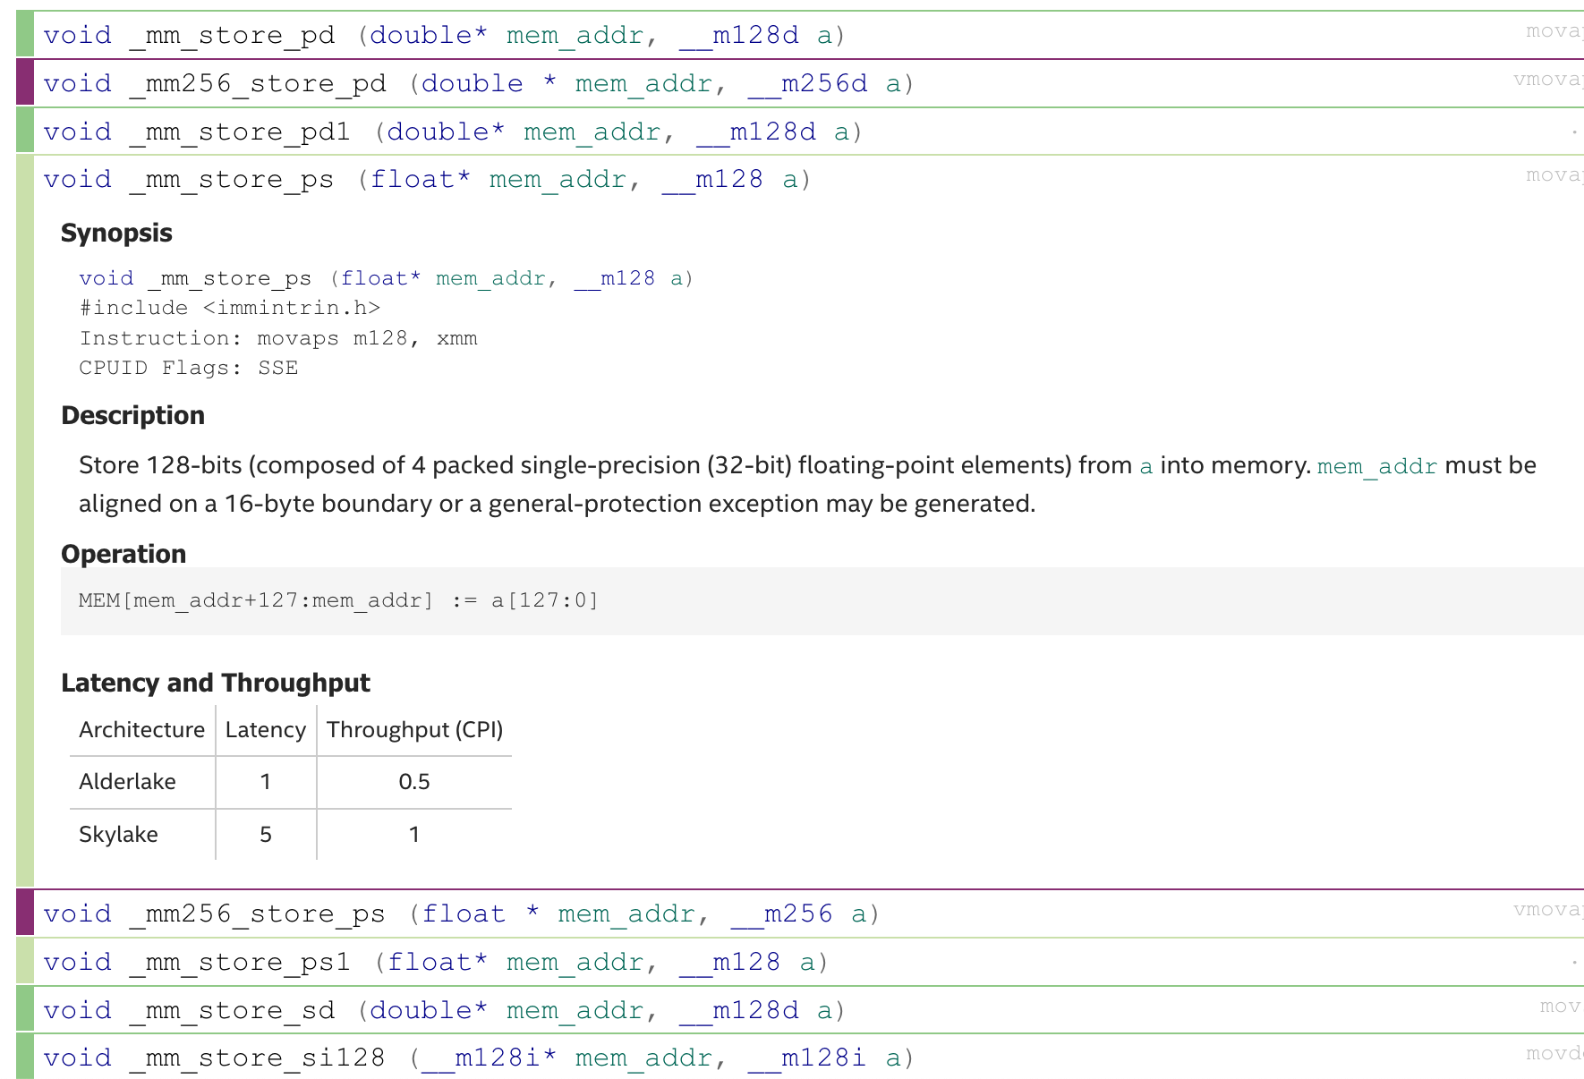
Store data from registers to memory
__m256 c;
float * p = ...;
_mm256_store_ps(p, c);

Slide 9

ARM Neon Intrinsics

Slide 10
SIMD@ARM
Neon: 64 bits and 128 bits
Helium (or MVE): More instructions
SVE (Scalable Vector Extension): 128 bits to 2048 bits
SVE2

Slide 11
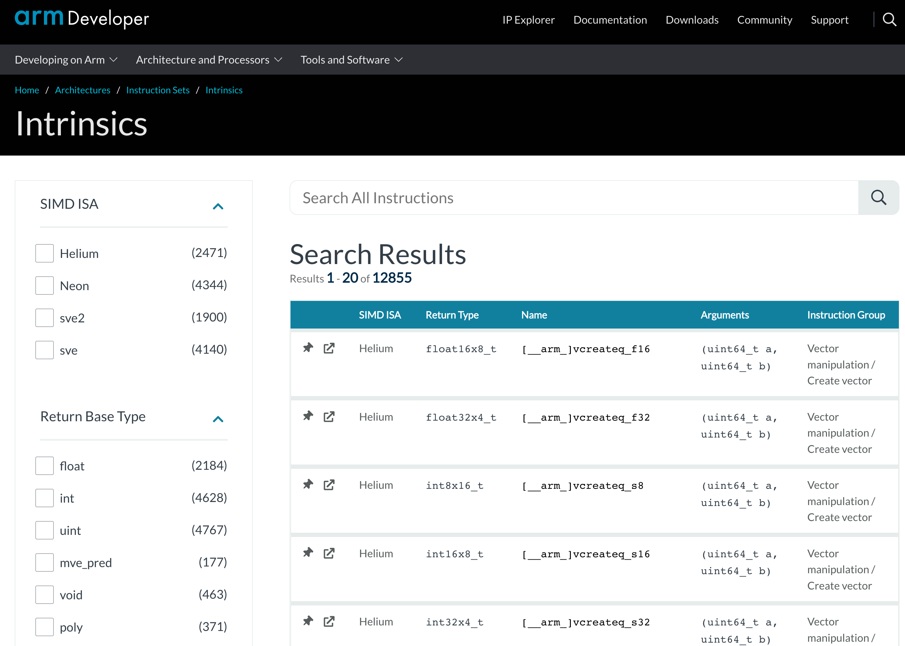
ARM Intrinsics
https://developer.arm.com/architectures/instruction-sets/intrinsics/

Slide 12
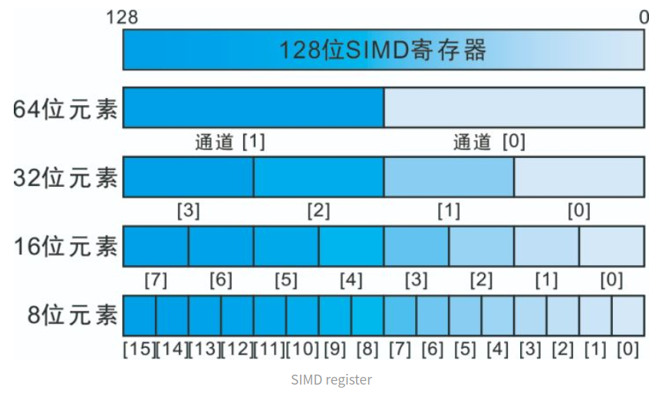
The NEON Intrinsics can operator on 128-bit registers
https://manzp.blog.csdn.net/article/details/114686930

Slide 13
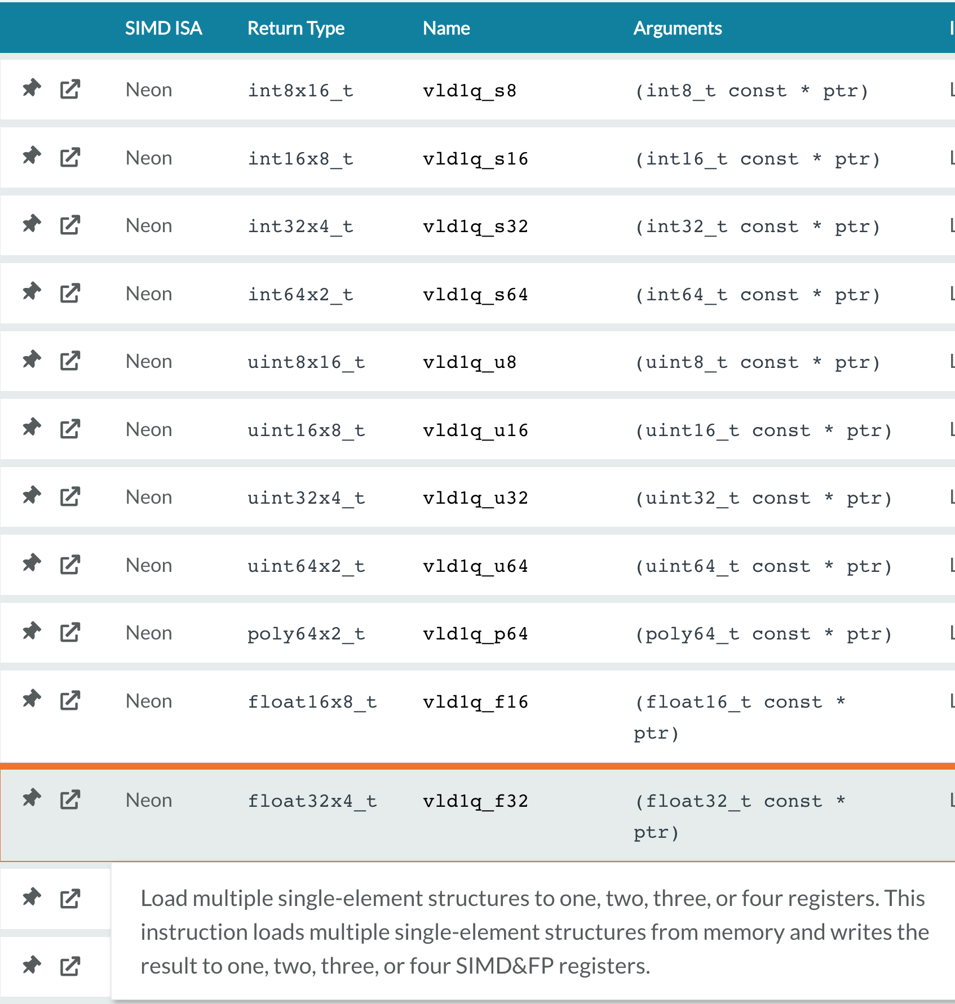
Load data from memory to registers

Slide 14
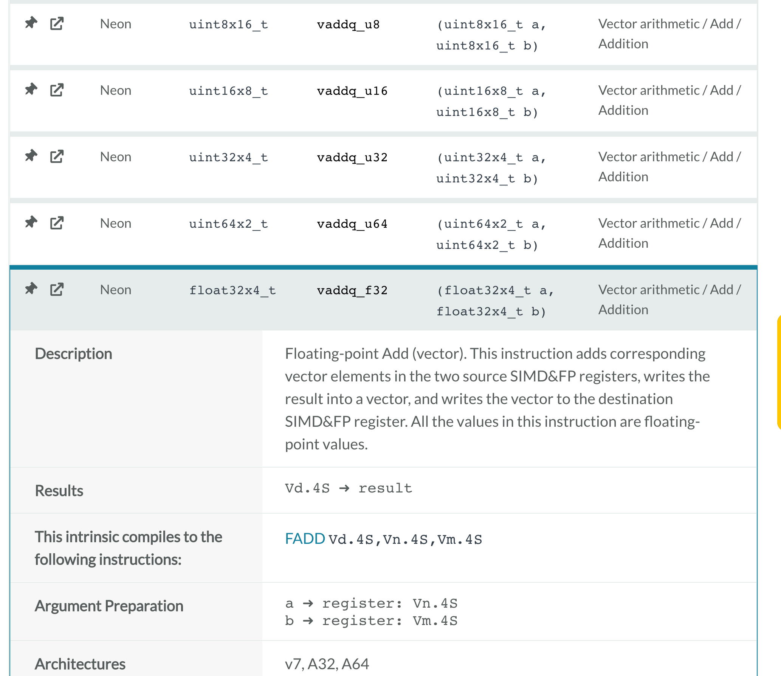
Add operation

Slide 15
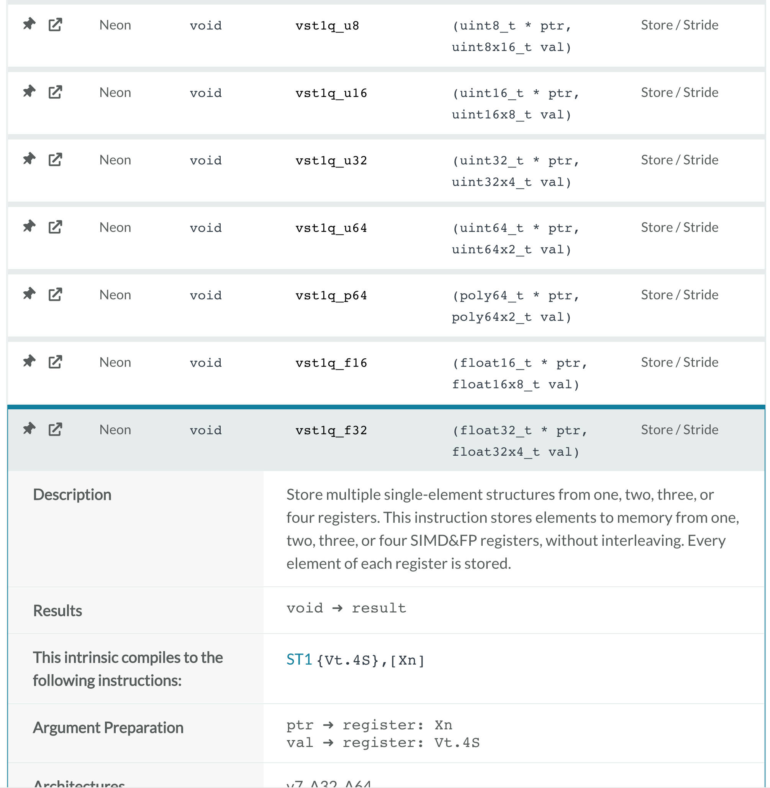
Store data from registers to memory

Slide 16
Some tips for the example of Week 8

Slide 17
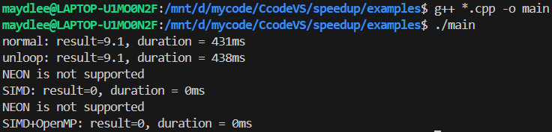
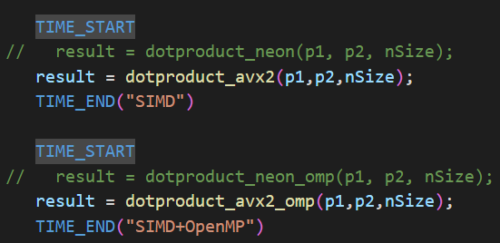
If you compile the source code using “g++ *.cpp –o main”
They mean you did not compile the
source code with NEON.
If you run the example at Intel CPU, please enable the function call of dotproduct_avx2() in main.cpp.

Slide 18
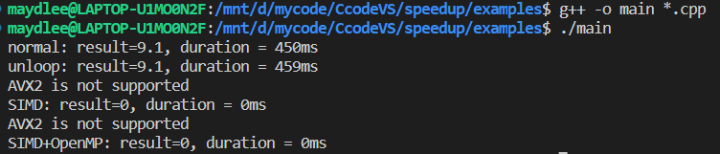
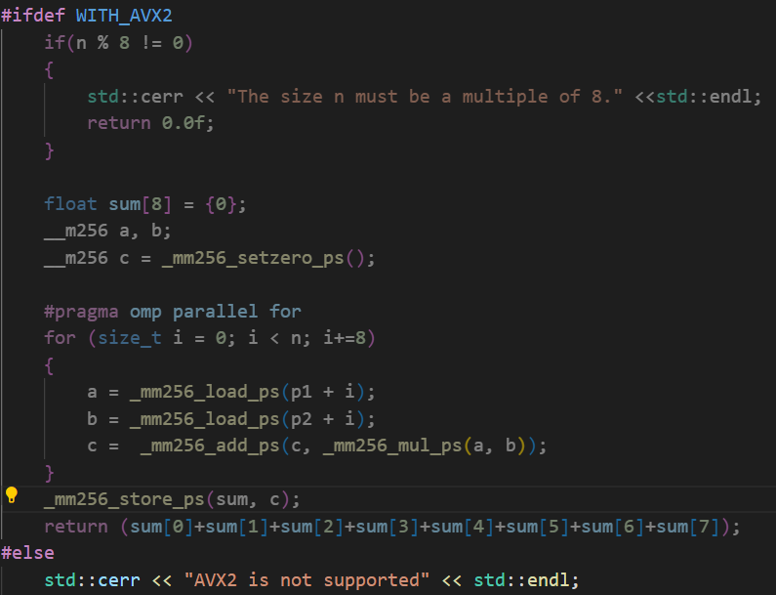
2. If you compile it again, the output still mentions AVX2 is not supported.
The macro WITH_AVX2 should be enabled when you compile.
No AVX2 support

Slide 19
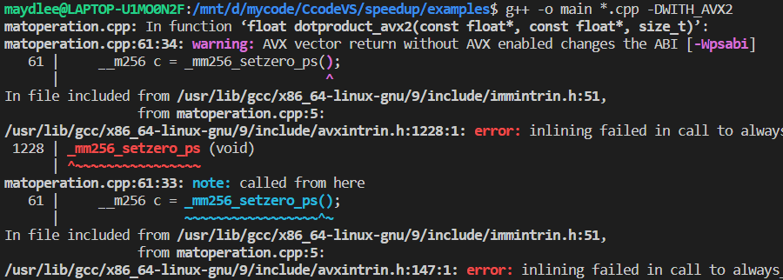
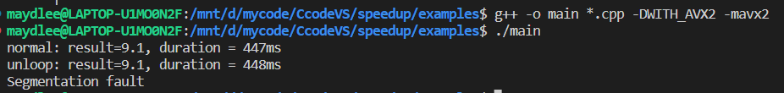
To enable the macro by the option -DWITH_AVX2
You may get the error message: error:inlining failed .. because you didn’t tell the compiler to enable AVX2.
Please use the option -mavx2 to let g++ enable AVX2 support.
运行到调用avx2指令时出现段错误

Slide 20
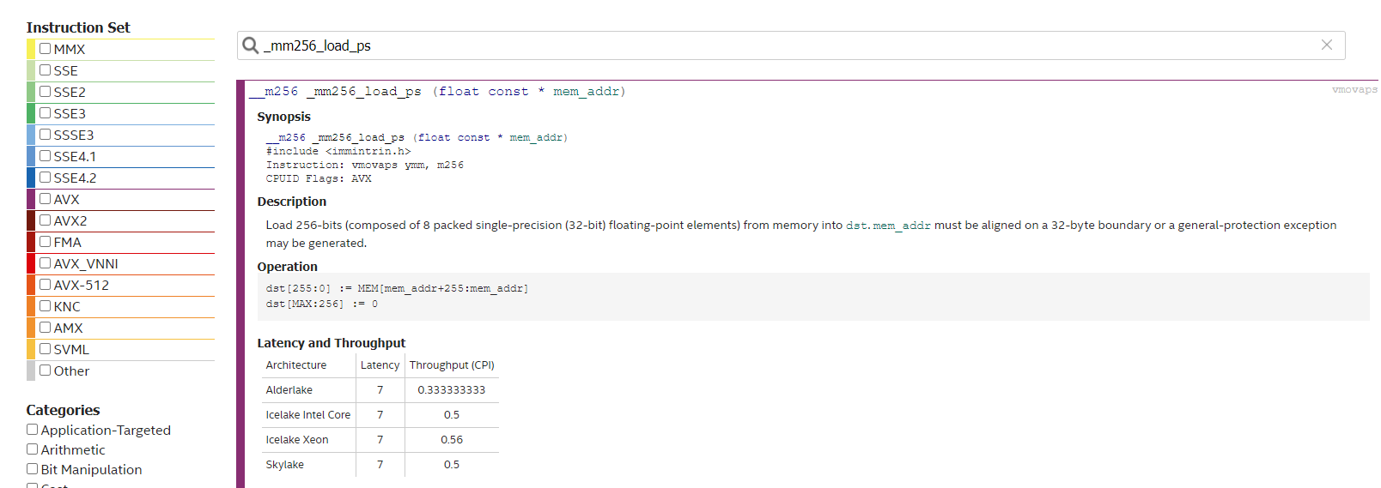
https://www.intel.com/content/www/us/en/docs/intrinsics-guide/index.html
Input the name you search
It means _mm256_load_ps() is in AVX (not AVX2)
The option -mavx is for AVX, and -mavx is for AVX2
g++ main.cpp matoperation.cpp -mavx
g++ main.cpp matoperation.cpp -mavx2

Slide 21
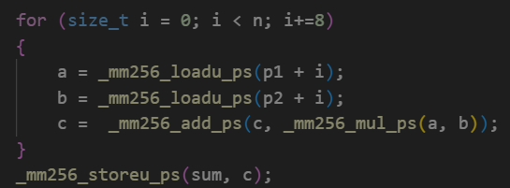
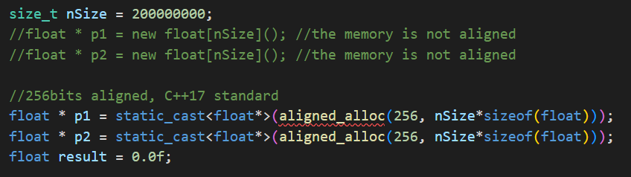
You still may get segment fault or wrong results.
①For Intel CPU, it’s better to use loadu & storeu, nor load/store.
②load and store are for aligned memory only.
_loadu here is for unaligned memeory
_storeu here is for unaligned memory
Unaligned memory allocation
Aligned memory allocation

Slide 22
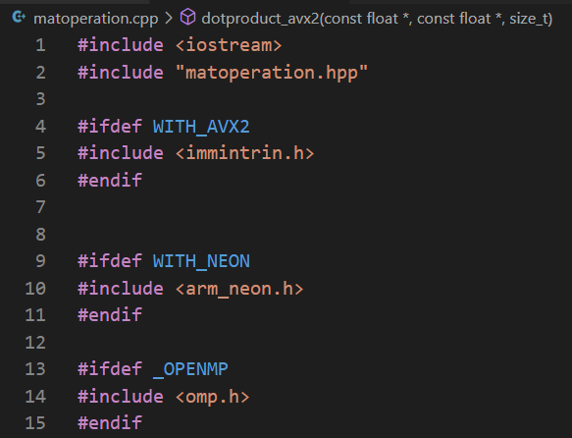
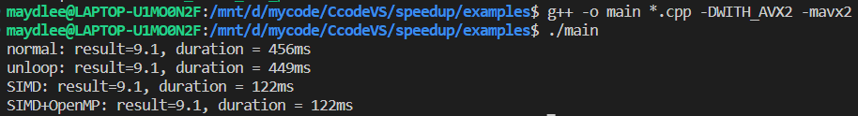
3. To include different header files by different macros.
If you CPU supports AVX2, enable the macro WITH_AVX2
If you CPU supports AVX2, enable the macro WITH_NEON
If you you want OpenMP
OpenMP没有启动

Slide 23
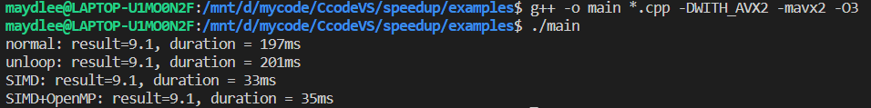
You can use –O3 to gain the maximum speed.

Slide 24
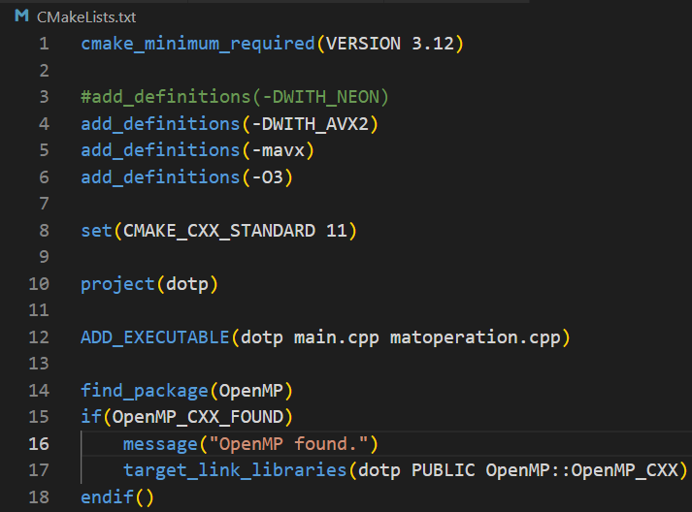
How to do the previous mentioned in CMakeLists.txt
Add some options for the compiler

Slide 25
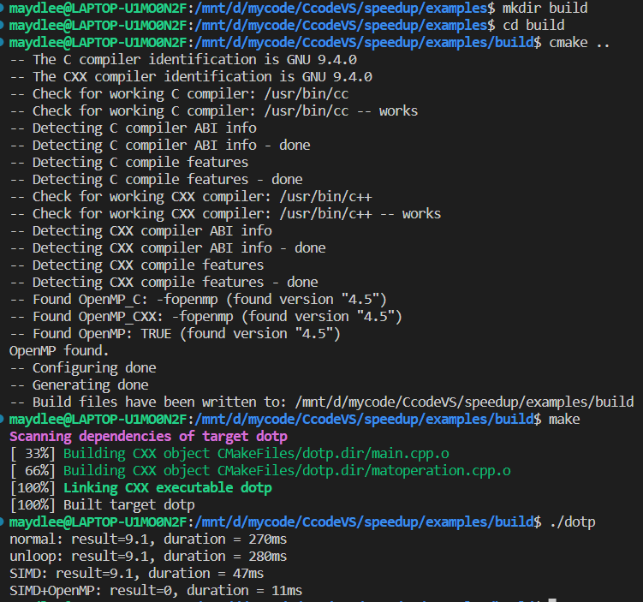
You can create a directory for generated files by cmake
To use the file CMakeLists.txt in the parent directory
Make it!
Run it!

Slide 26
Exercise:
Write a program to add 2 float vectors whose size should be more than 1M. The result is a vector of the same size with the input 2 vectors. You can initialize the two vectors with values like 0.f, 1.f, 2.f, …
Use pure C source code and SIMD (AVX2 or NEON) separately, and compare their speeds
Use OpenMP to speed up the addition. Can you get the correct result?

Slide 27

Introduction to Python(1)
Python is an interpreted high-level object-oriented programming language.
First release in 1991.
Official Tutorial: https://docs.python.org/3/tutorial/
Quick Start Guide for Python in VS Code
https://code.visualstudio.com/docs/python/python-quick-start

Slide 28
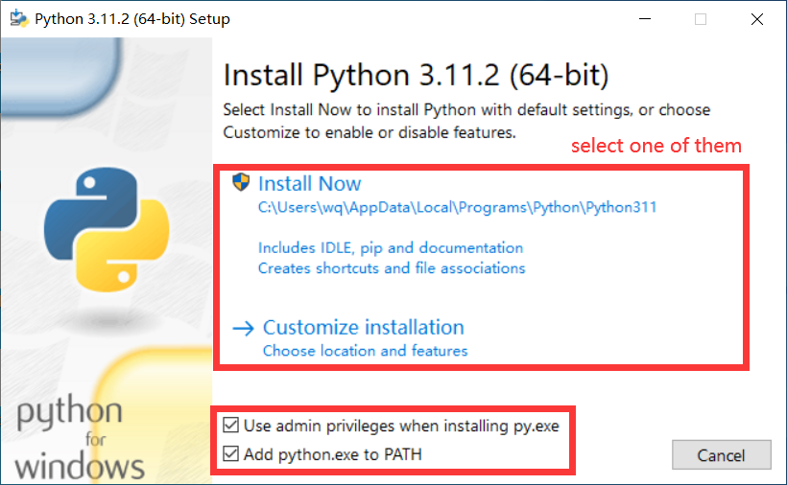
Install python(1)
The installation package can be got from https://www.python.org/downloads/
You can choose install it by default settings or customize installation.
It is highly recommend that choose ‘Add python.exe to PATH’, or you need to set PATH by hand as next page shows.

Slide 29
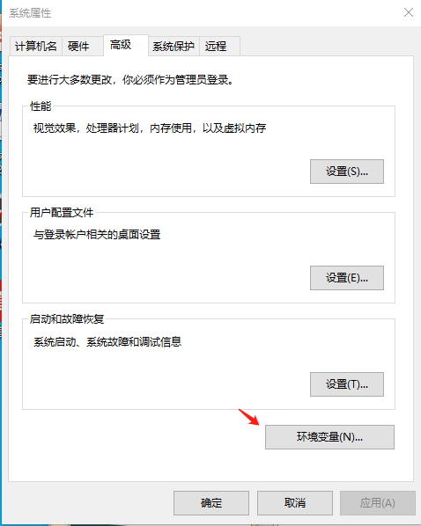
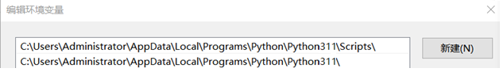
Install python(2)
If the ‘Add python.exe to PATH’ is not set while installing, configure ‘Path’ manually according to the following steps after the installation.
Right click ‘my computer’ on the desktop
select ‘attribute’-> ‘advanced attribute’->environment variable
configure ‘Path’ with the path where python.exe belongs and its subdirectory ‘Scripts’

Slide 30
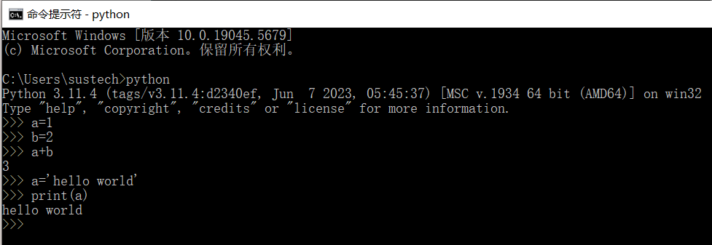
Read-Eval-Print Loop
Python has an REPL playground.
Type and get feedback.

Slide 31
Basic Types and Operations
The following standard types are built in the interpreter:
Numeric Types — int, float, complex
Boolean Type — True, False
Text Sequence Type — str
Sequence Types — list, tuple, range
Set Type & Dict Type
Binary Sequence Types — bytes, byte array
There are predefined operations on each type
Ref: https://docs.python.org/3/library/stdtypes.html

Slide 32
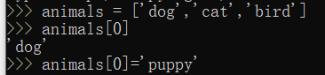
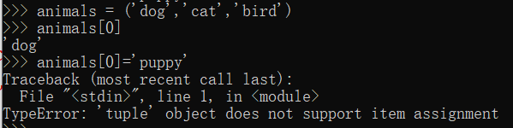
Sequence Types
List
animals = ['dog', 'cat', 'bird']
animals[0] # => 'dog'
animals[0] = 'puppy'
Tuple
animals = ('dog', 'cat', 'bird')
animals[0] # => 'dog'
animals[0] = 'puppy'
Traceback (most recent call last):
File "<stdin>", line 1, in <module>
TypeError: 'tuple' object does not support item assignment

Slide 33
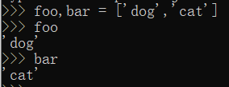
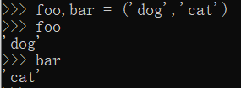
Unpacking from Sequence Types
List
foo, bar = ['dog', 'cat']
foo # => 'dog'
bar # => 'cat'
Tuple
foo, bar = ('dog', 'cat')
foo # => 'dog'
bar # => 'cat'

Slide 34
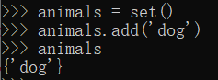
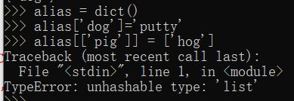
Set & Dict
Set
animals = set()
animals.add('dog')
animals # => {'dog'}
Dict
alias = dict()
alias['dog'] = 'puppy'
alias[['pig']] = ['hog']
Traceback (most recent call last):
File "<stdin>", line 1, in <module>
TypeError: unhashable type: 'list'

Slide 35
Immutable & Mutable
Mutable: it is possible to change its content
Immutable Type: Numeric, Boolean, str, tuple, bytes, etc.
Mutable Type: list, dict, set, etc.
Example:
>>> cubes = [1, 8, 27, 65, 125] # cubes here is a list
>>> cubes[3] = 64 # replace the item whose index is 3
>>> cubes
[1, 8, 27, 64, 125]
Only Immutable types can be key of dict or member of set.

Slide 36
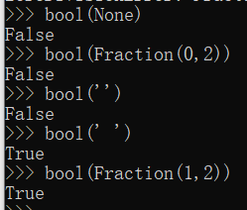
Boolean Values
Following values are treated as False:
None, False
0, 0.0, 0j, Decimal(0), Fraction(0, 1)
'', (), [], {}, set(), range(0)
Otherwise they are True

Slide 37
Flow Control — if
foo = []
if foo:
print(foo)
else:
if foo == []:
print('100% sure foo is empty')
else:
print('what hell?')
foo = [1, 2, 3, 4]
if foo:
print(foo)
else:
if foo == []: print('100% sure foo is empty')
else:
print('what hell?')

Slide 38
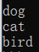
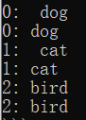
Flow Control — for
foo = ['dog', 'cat', 'bird']
for bar in foo:
print(bar)
for index, value in enumerate(foo): print('%d: %4s' % (index, value))
print('{0}: {1}'.format(index, value))
for i in range(10):
print(i,end=” ”)

Slide 39
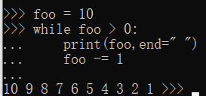
Flow Control — while
Example:
foo = 10
while foo > 0:
print(foo, end=” ”)
foo -= 1

Slide 40
Defining Functions
def fib(n): # write Fibonacci series up to n
a, b = 0, 1
while a < n:
print(a, end=' ')
a, b = b, a+b
print()
def fib2(n): # return Fibonacci series up to n
result = []
a, b = 0, 1
while a < n:
result.append(a)
a, b = b, a+b
return result

Slide 41
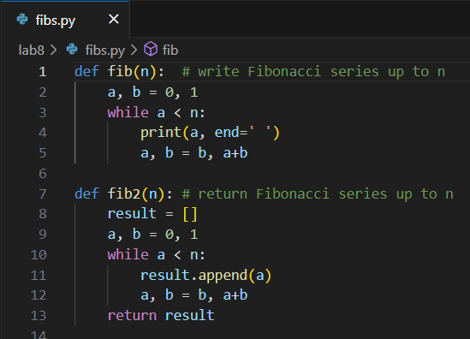
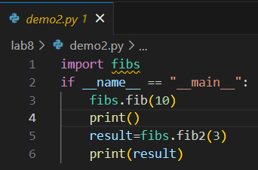
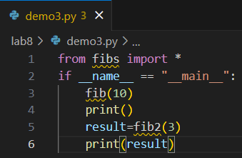
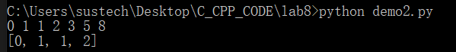
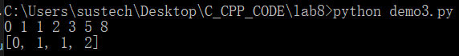
Module
file name without suffix is the module name

Slide 42
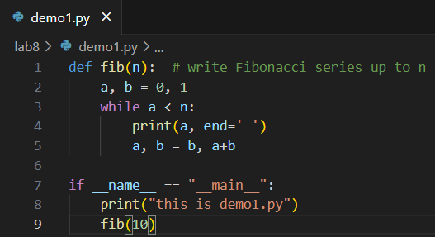
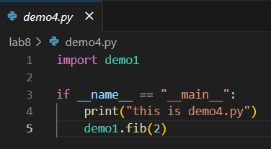
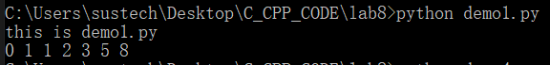
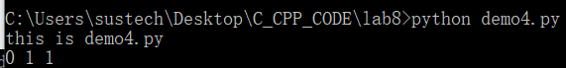
if __name__ == __main__:
https://docs.python.org/3/library/__main__.html#module-__main__

